Slide 1
Analyzing Azure Cosmos DB Data
With Azure Synapse Link (& others)

Slide 2








contact
Koen Verbeeck
@Ko_Ver
@koen@dataplatform.social
SQLkover.com

Slide 3
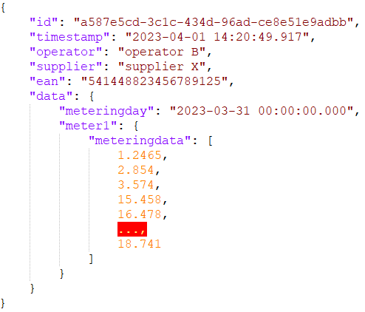



the use case
operator A
operator B
operator C
how are we going to query this data?

Slide 4

what are we going to talk about
Azure Cosmos DB recap
the Analytical Store
Azure Synapse Link
alternatives

Slide 5
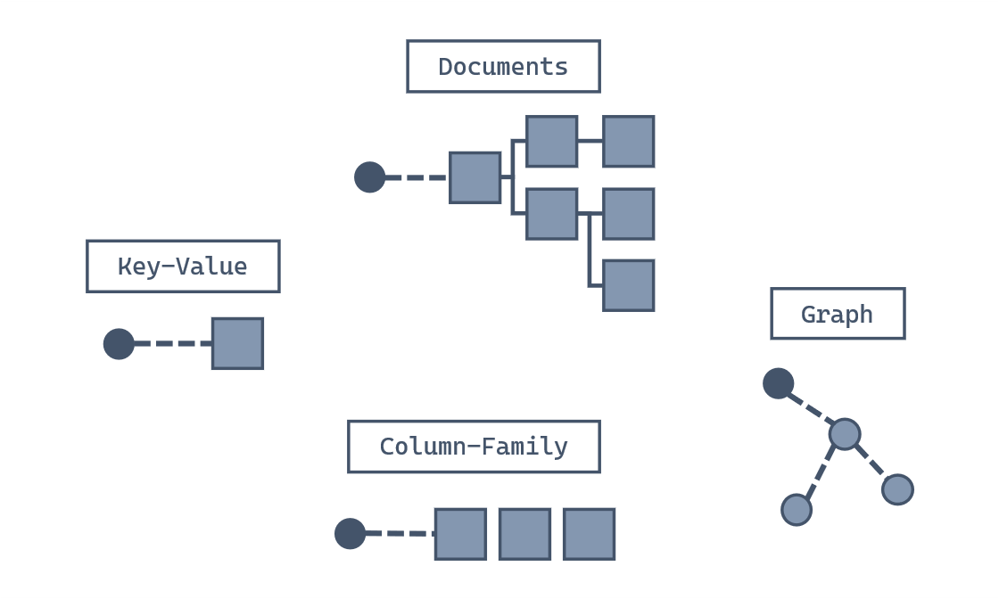
Azure Cosmos DB
SQL API
https://learn.microsoft.com/en-us/training/modules/introduction-to-azure-cosmos-db-sql-api/2-what-azure-cosmos-db-sql-api

Slide 6
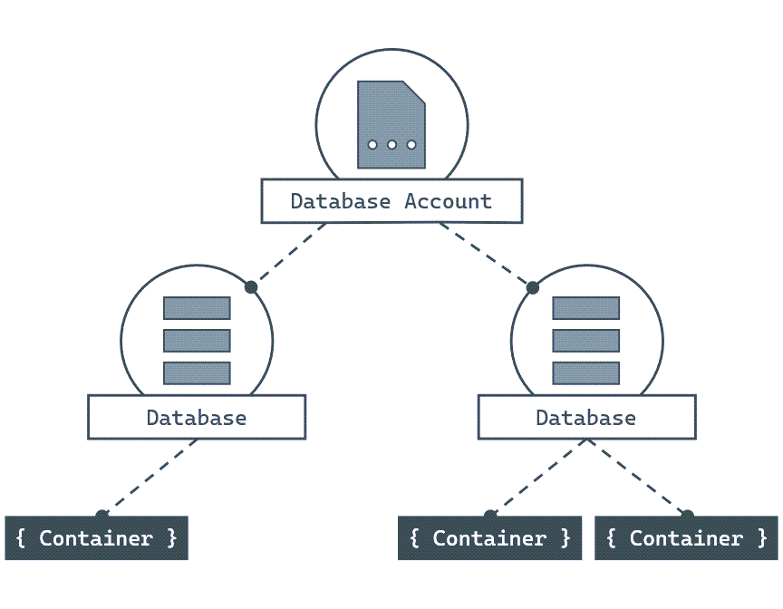
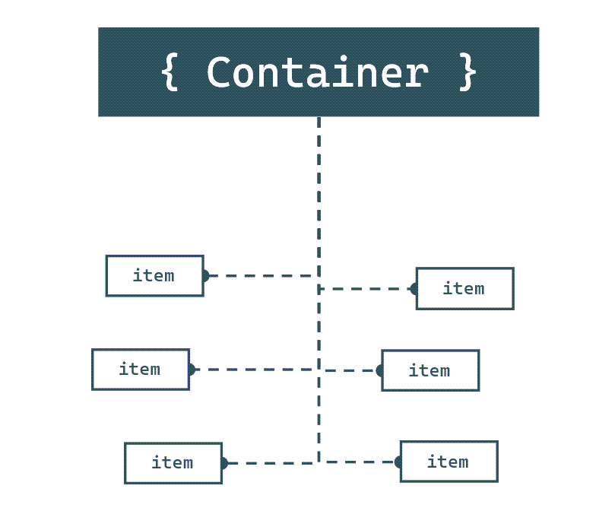
SQL API - structure
https://learn.microsoft.com/en-us/training/modules/introduction-to-azure-cosmos-db-sql-api/3-how-does-work

Slide 7
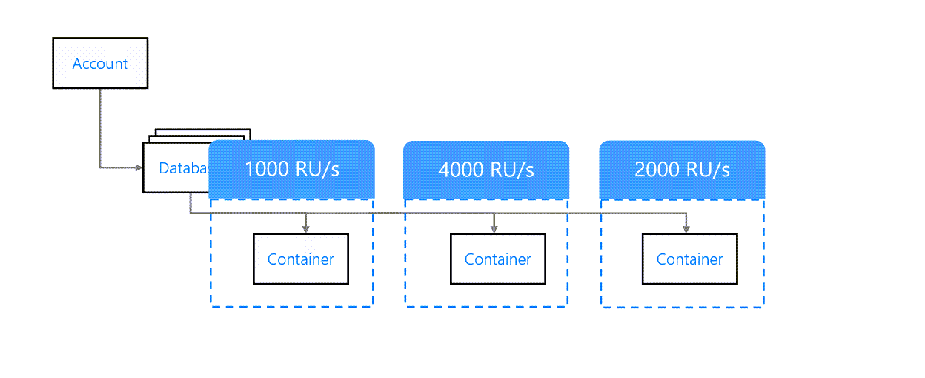
throughput
https://learn.microsoft.com/en-us/training/modules/plan-resource-requirements/2-understand-throughput

Slide 8
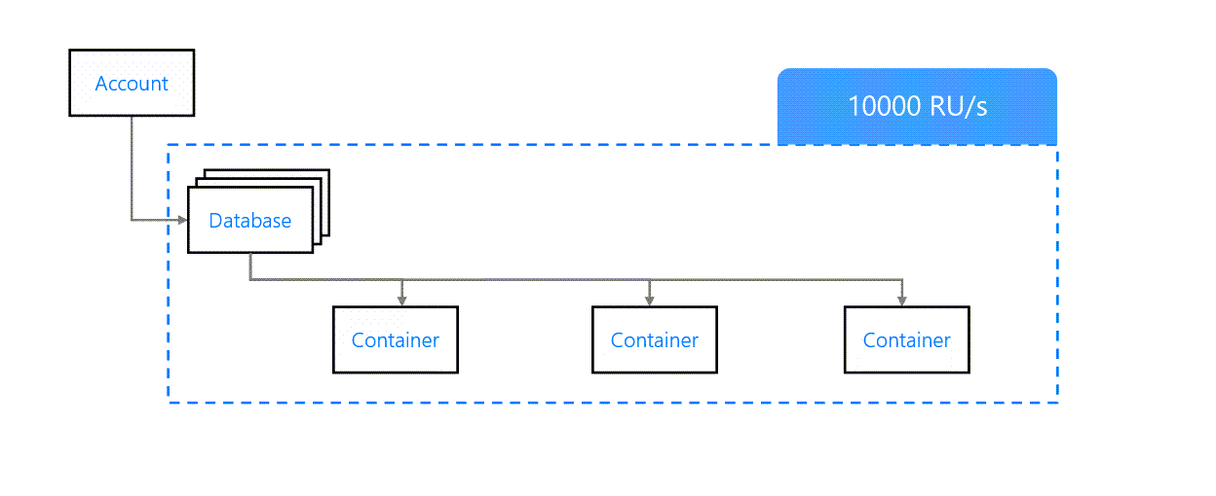
throughput
https://learn.microsoft.com/en-us/training/modules/plan-resource-requirements/2-understand-throughput

Slide 9
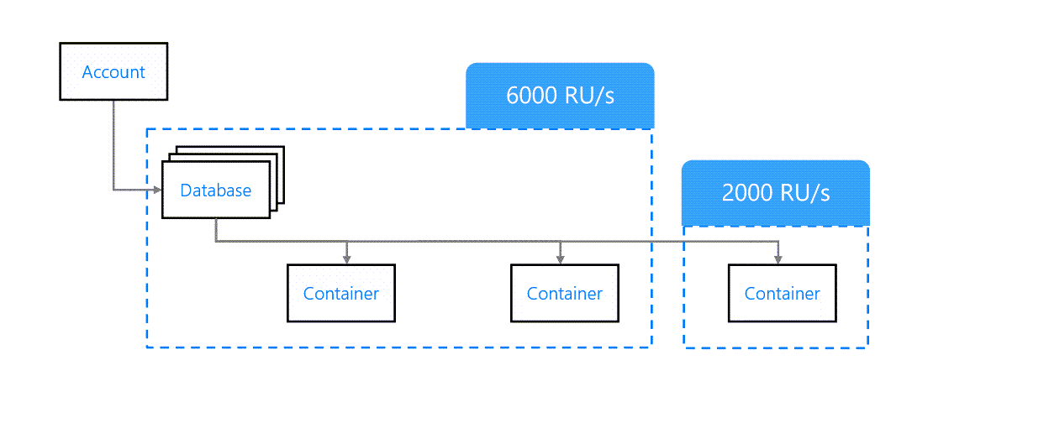
throughput
https://learn.microsoft.com/en-us/training/modules/plan-resource-requirements/2-understand-throughput

Slide 10
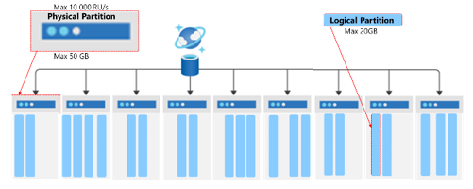
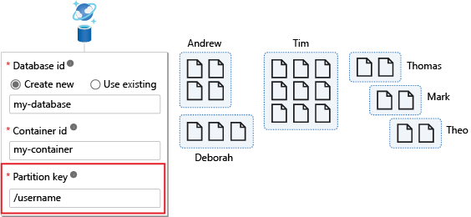
partition key
https://learn.microsoft.com/en-us/training/modules/implement-non-relational-data-model/6-choose-partition-key

Slide 11
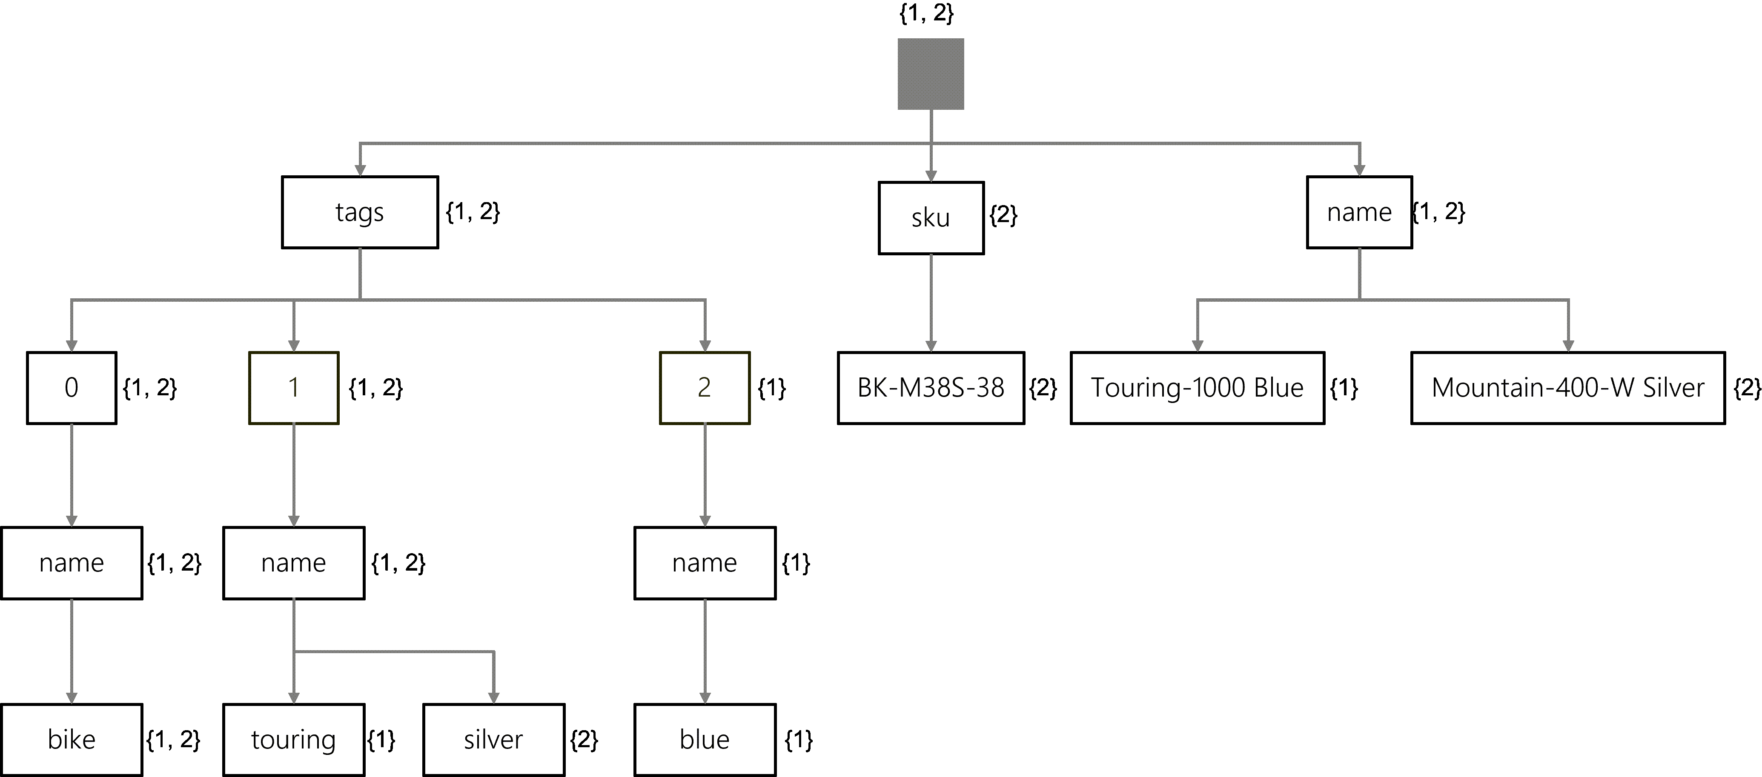
indexing
https://learn.microsoft.com/en-us/training/modules/define-indexes-azure-cosmos-db-sql-api/2-understand-indexes

Slide 12
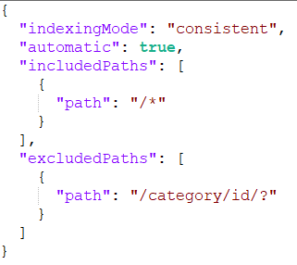
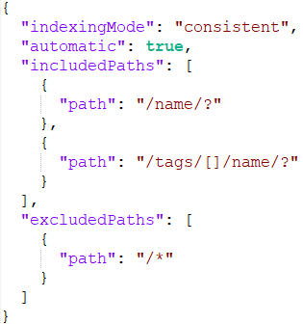
indexing policy

Slide 13
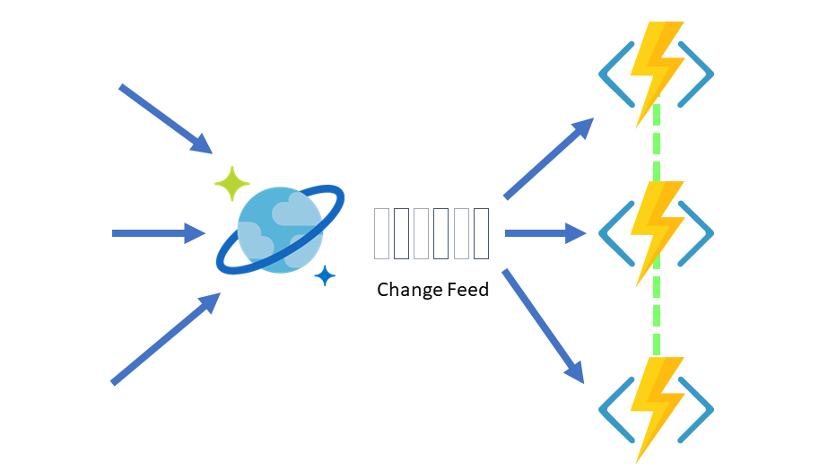
change feed

Slide 14

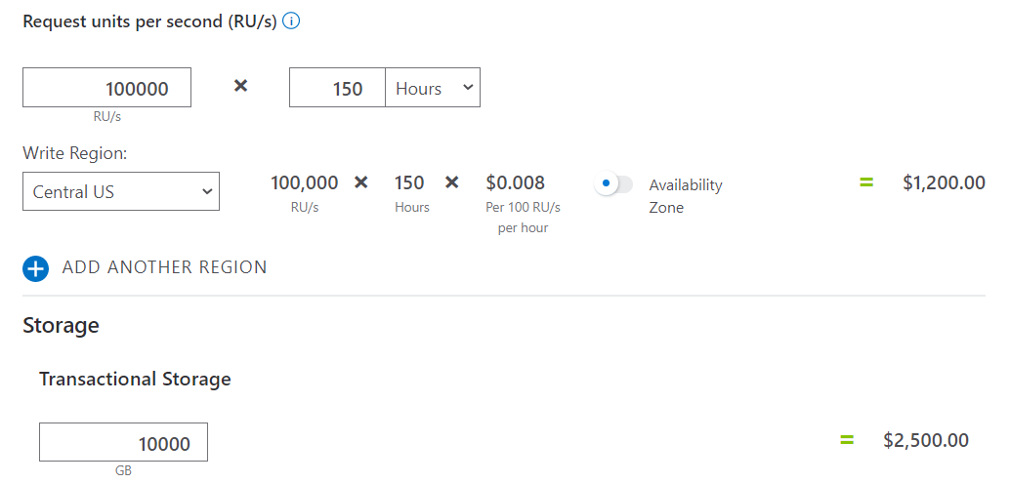
pricing

Slide 15

the use case
operator A
operator B
operator C
how are we going to query this data?

Slide 16
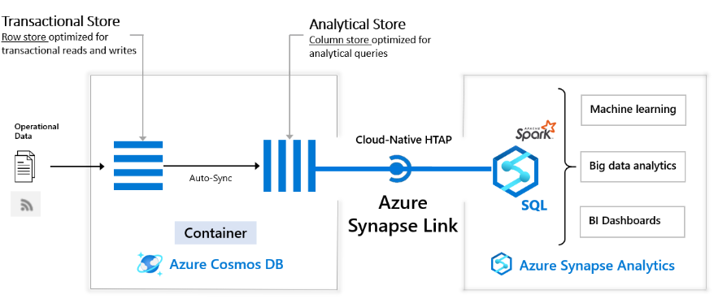
analytical store
Source: What is Azure Synapse Link for Azure Cosmos DB?

Slide 17
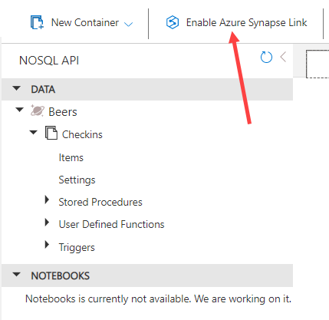
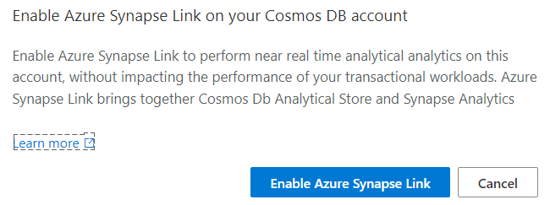
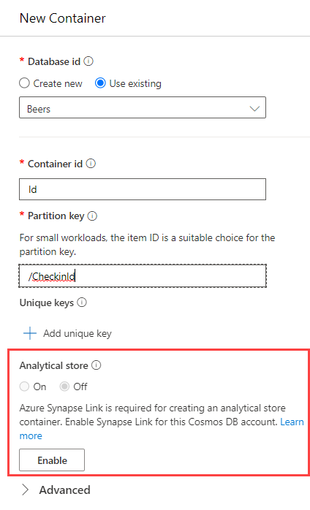
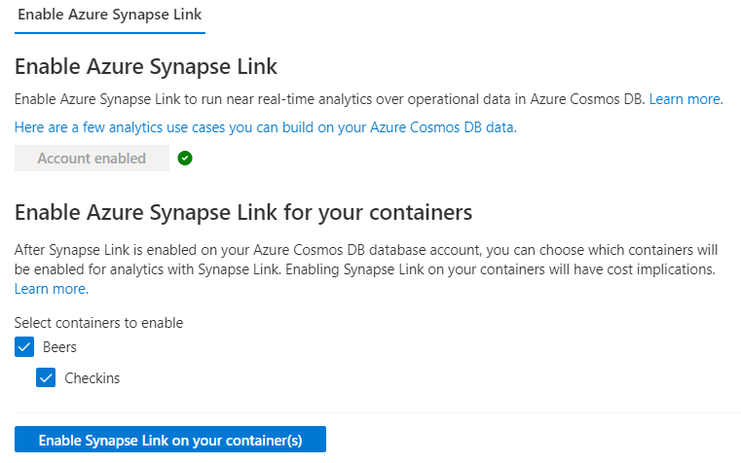
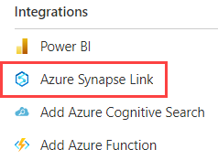
enable analytical store

Slide 18
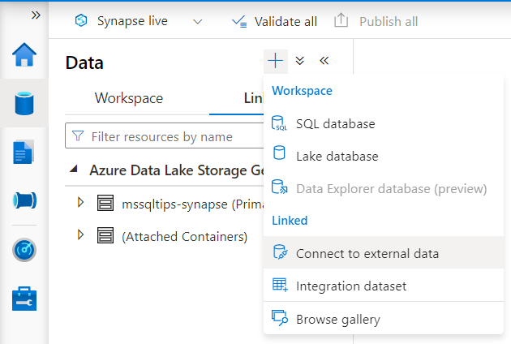
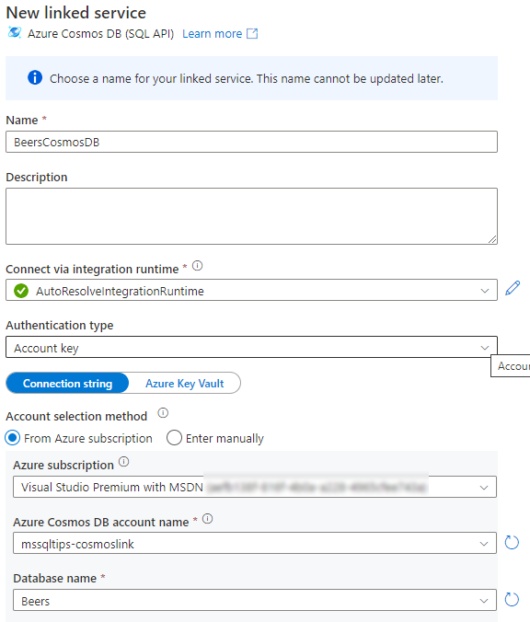
connect to external data

Slide 19
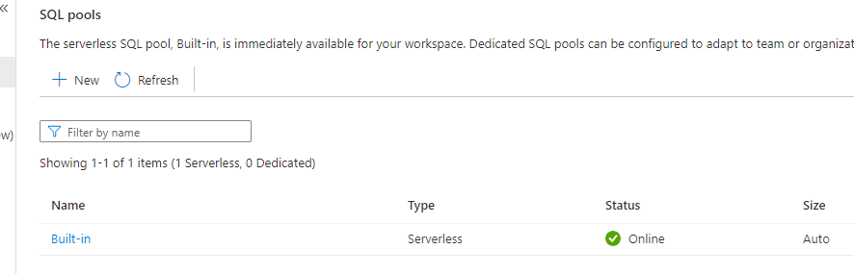
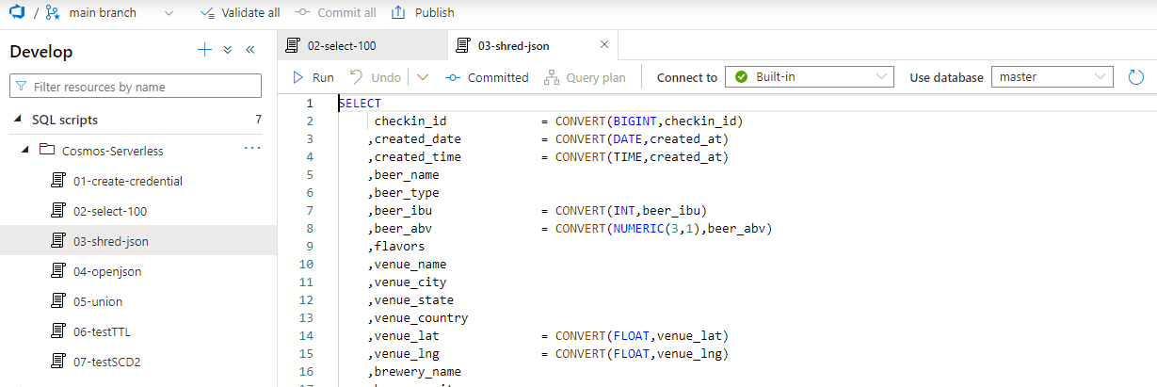
serverless SQL pools

Slide 20

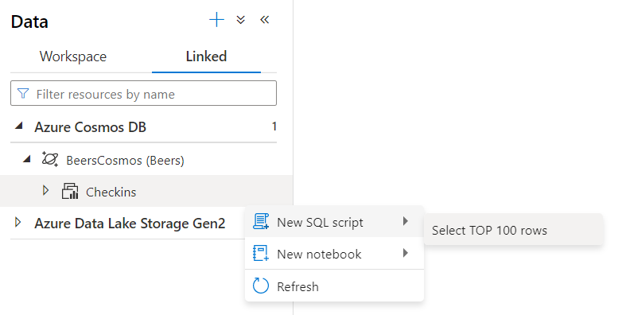
create credential
CREATE CREDENTIAL [myCosmosServerCredential]
WITH IDENTITY = 'SHARED ACCESS SIGNATURE', SECRET = 'mysecretkey'

Slide 21

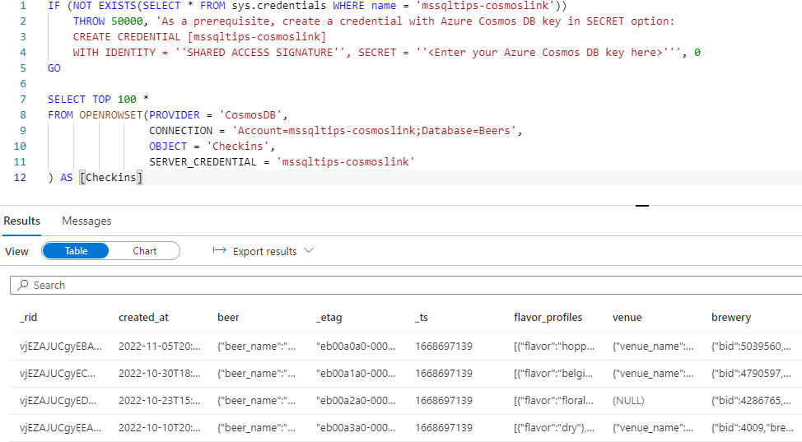
profit!

Slide 22
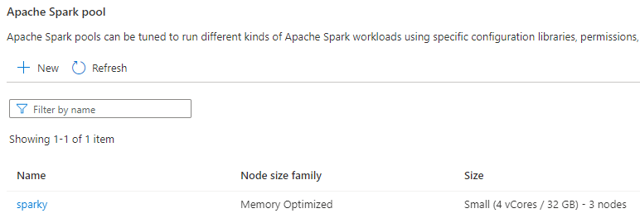
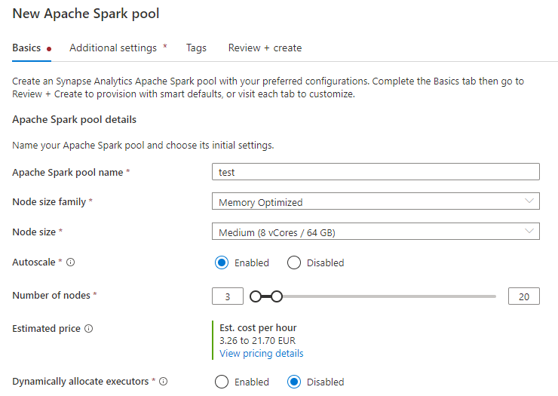
Spark pools

Slide 23
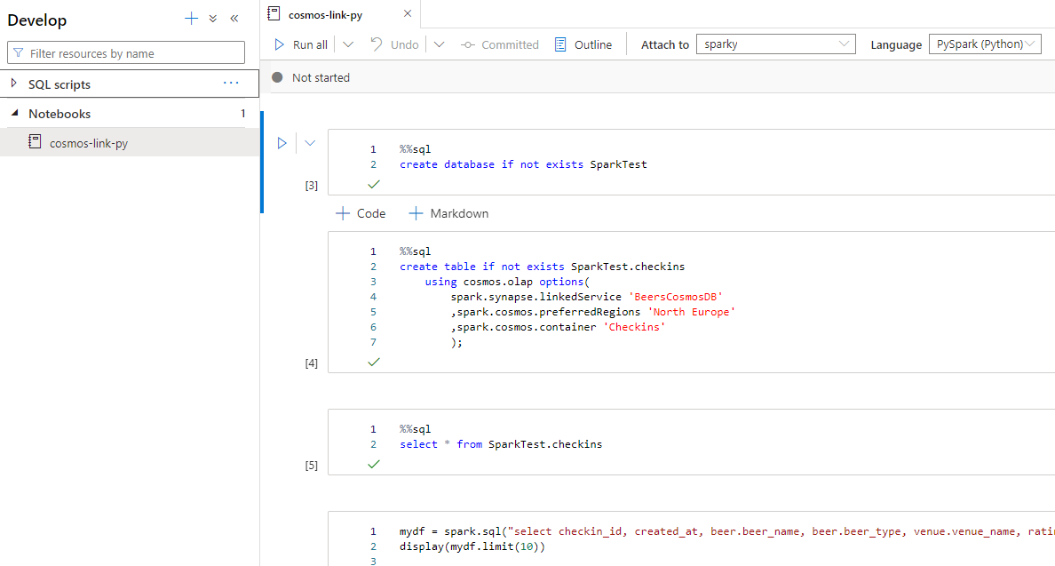
notebooks

Slide 24
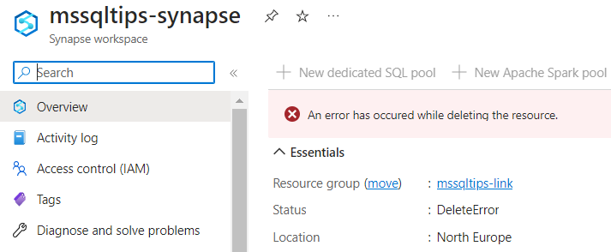
whatever you do…

Slide 25
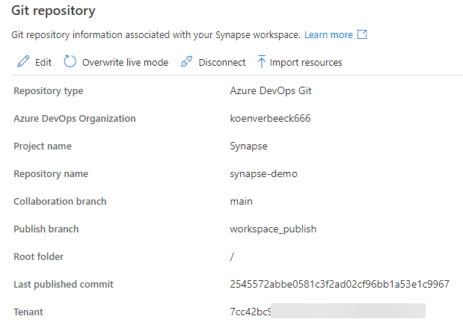
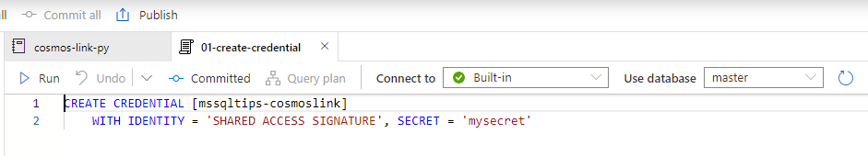
… make sure it’s in git

Slide 26
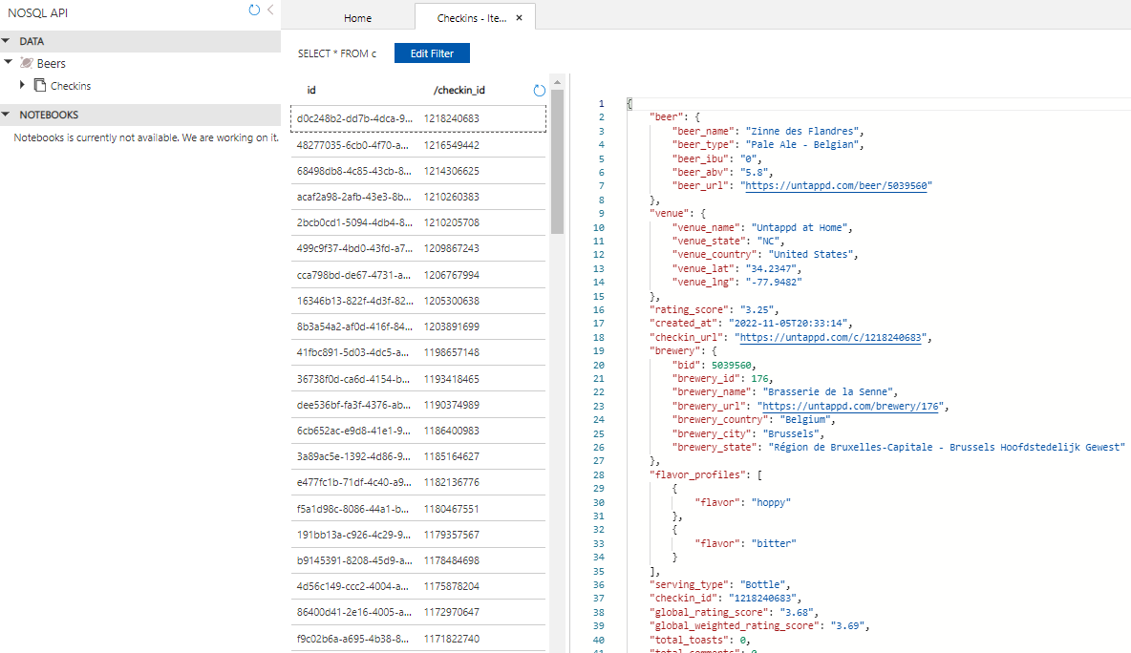

demo data

Slide 27

DEMO

Slide 28

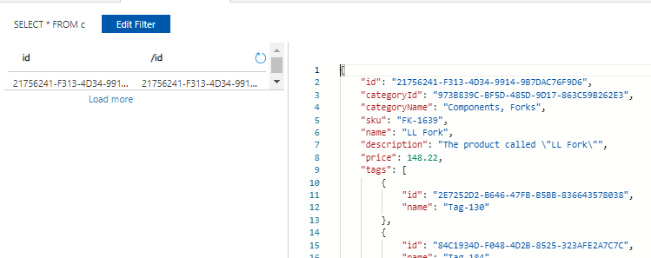

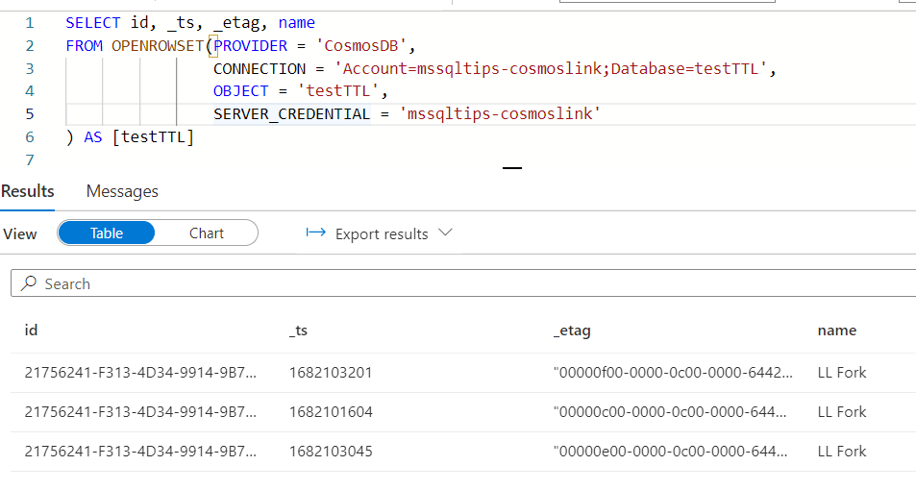

strange behavior?

Slide 29
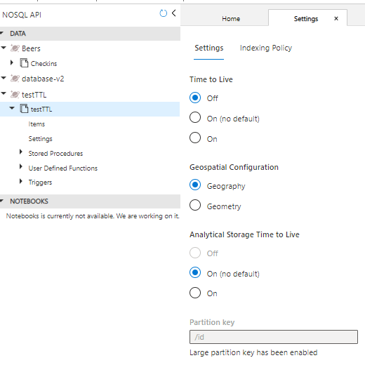
TTL vs ATTL

Slide 30
conclusion
Azure Synapse Serverless SQL Pools is NOT AN ETL TOOL
You cannot overwrite an “external table”
Deleting the table first doesn’t work
There are specific performance optimizations when working with Synapse Link for Azure Cosmos DB
Set database in a UTF-8 collation
Explicitly set schema
Filter data in WHERE clause
Best practices for integrating serverless SQL pool with Cosmos DB Analytical store via Synapse Link
Optimize database schema in serverless SQL pools using QPI library

Slide 31
alternatives
dump the data somewhere else
either by the original process
but what about updates/deletes?
read the data with the ETL/ELT tool of your choice, and store it in a data lake/lakehouse/data warehouse/whatever
ADF can have some trouble with complex JSON

Slide 32
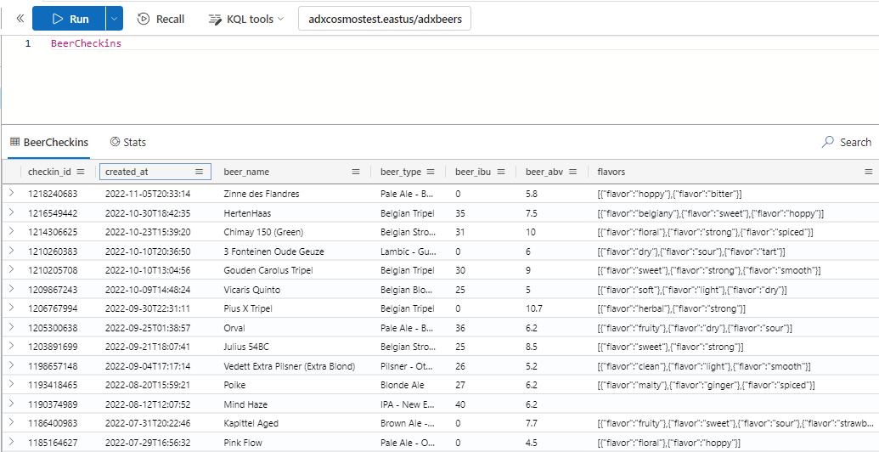
alternatives
Azure Synapse Link for Cosmos DB to Azure Data Explorer (preview)

Slide 33
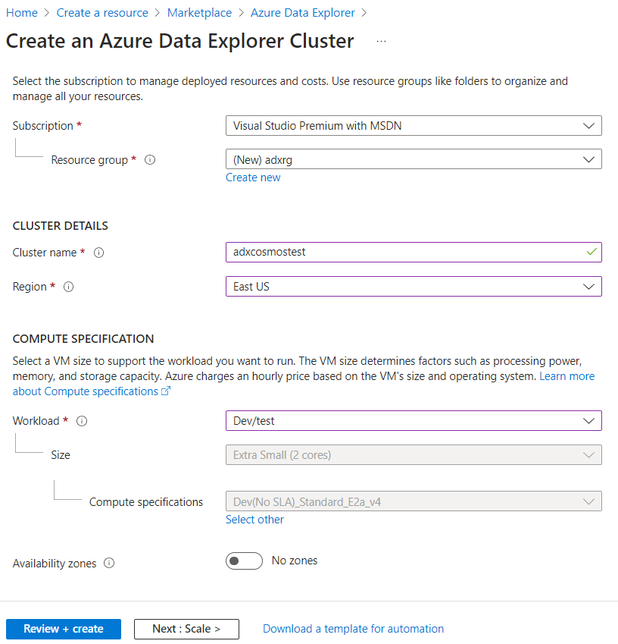
ADX
there’s also ADX pools in Azure Synapse (preview)
this scenario isn’t supported yet

Slide 34
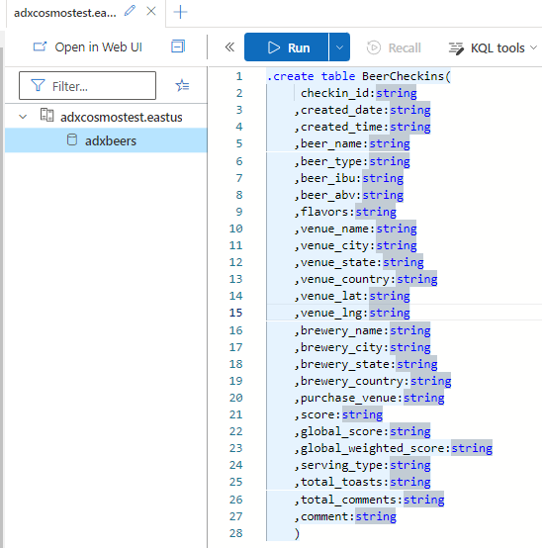
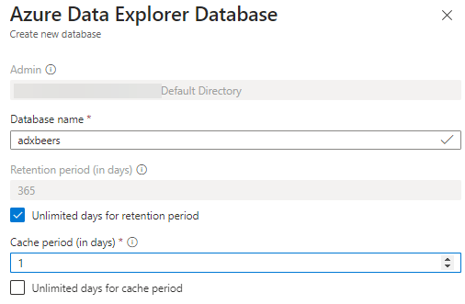
ADX

Slide 35
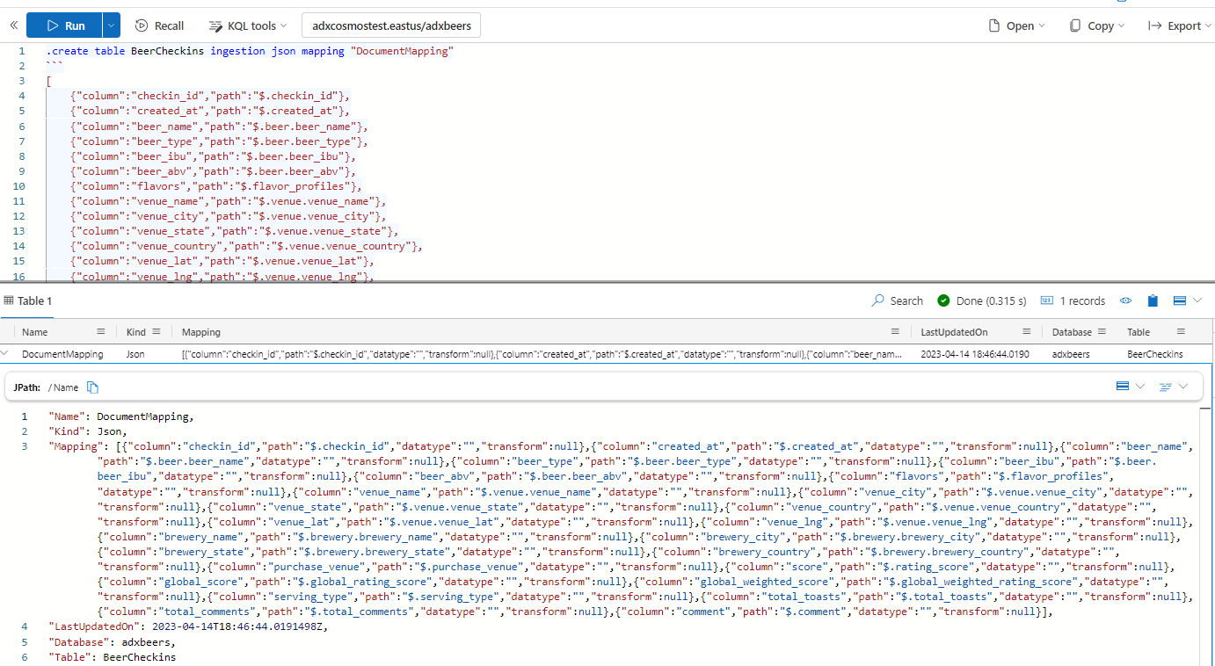
ADX

Slide 36
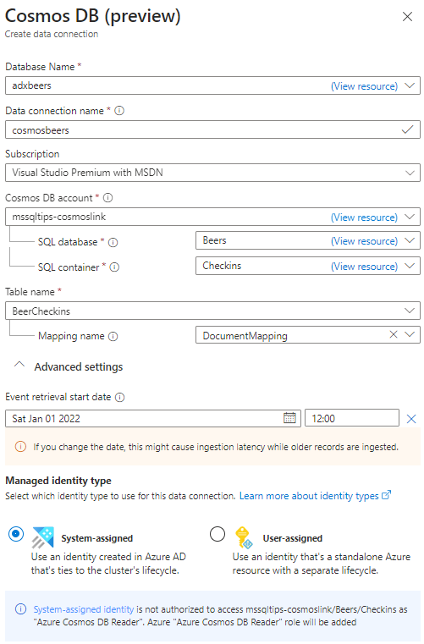
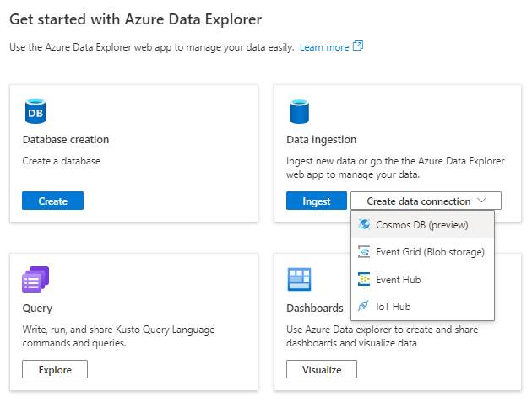
ADX

Slide 37
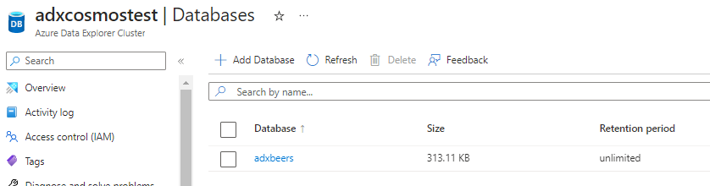

ADX
data will be imported from the specified start date
when it’s imported, you can query it with KQL

Slide 38

DEMO

Slide 39
Serverless vs ADX
Serverless
no size config
$$$ = #TB scanned
SQL
data “stays” in source (analytical store)
ad-hoc analysis pass-through for other tools
Data Explorer
cluster size is specified
$$$ = #min cluster is running + storage
KQL
data is copied to ADX - append-only (using Cosmos change feed)
ad-hoc analysis (can be used as pass-through as well)

Slide 40
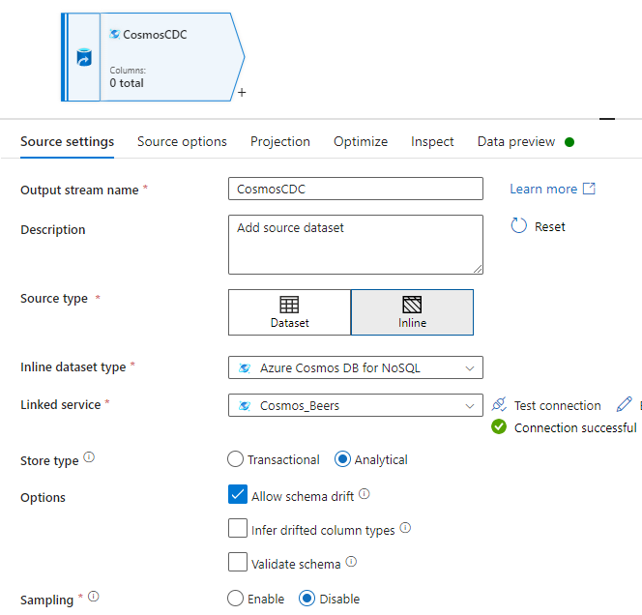
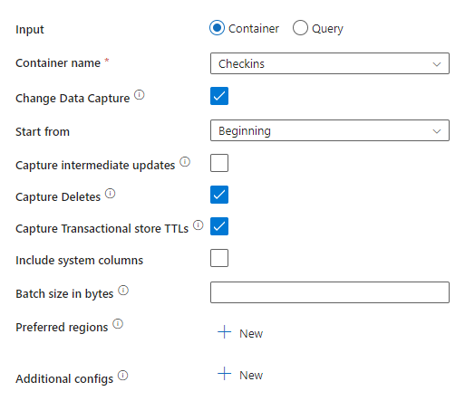
alternatives
data flow in ADF (supports CDC)

Slide 41
Serverless vs ADF
Serverless
no size config
$$$ = #TB scanned
SQL
data “stays” in source (analytical store)
ADF data flow
cluster size is specified
$$$ = #min cluster is running
no code (but you can write SQL)
data is copied from analytical store
you need a sink (not a query engine)

Slide 42

conclusion
there are multiple options to read/analyze data from Cosmos DB
either use the analytical store or copy data
cheapest option is probably serverless
but test for your use case

Slide 43
resources
Cosmos DB Learning Path
How to Install Cosmicworks Sample Database in Azure Cosmos DB
What is Azure Cosmos DB analytical store?
Analyze Azure Cosmos DB data with Synapse Serverless SQL Pools
Azure Cosmos DB to Azure Data Explorer Synapse Link – YouTube
Cosmos Down Under – Podcast
Capture Changed Data From your Cosmos DB analytical store (ADF)

Slide 44

And please give feedback!

